Slide 1

Biological Databases: Theories and Practice
430032
PHP Programming II
Instructor: Prof. LEE, Tzong-Yi (李宗夷)
Email: leetzongyi@nycu.edu.ctw
Professor
Institute of Bioinformatics and Systems Biology,
National Yang Ming Chiao Tung University
结合传统与现代
融会中国与西方

Slide 2
Outline
Interaction between HTML and PHP
GET and POST methods
File Upload
GD Image Library
Notes:
1

Slide 3
Interaction between HTML and PHP
The method attribute of the form element tells the web browser how to send form data to a server. (https://html.com/attributes/form-method/#ltform_method8221GET8221gt)
<form method=”GET”>
Specifying a value of GET means the browser will add the form contents to the end of the URL. GET results in the entire contents of the submission being visible in the URL.
<form method=”POST”>
Specifying a value of POST means the browser will send the data to the web server to be processed. This is necessary when adding data to a database, or when submitting sensitive information, such as passwords.

Slide 4
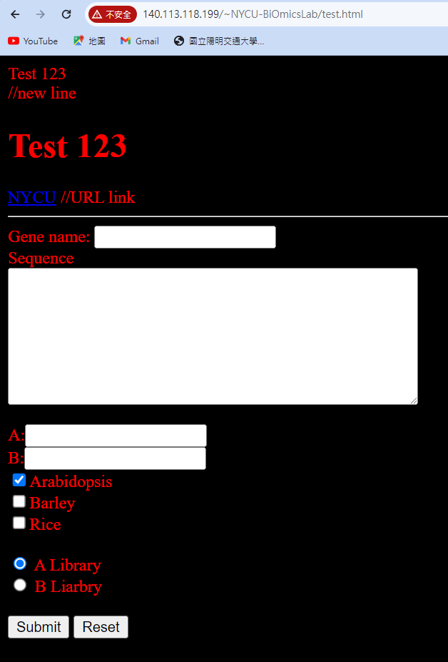
Example: http://140.113.118.199/~NYCU-BiOmicsLab/test.html
<html>
<head>
<title>HTML Test Page</title>
</head>
<body text="red" bgcolor="#000000">
Test 123 <br> //new line
<H1>Test 123</H1>
<a href=‘http://www.nycu.edu.tw>NYCU</a> //URL link
<hr>
<form id="form“ method="get“ action="result.php">
Gene name: <input name="seq_name" type="text"><br>
Sequence <br>
<textarea name="sequence" cols="50" rows="8">
</textarea> <br><br>
………………….
………………….
</form>
</body>
</html>

Slide 5
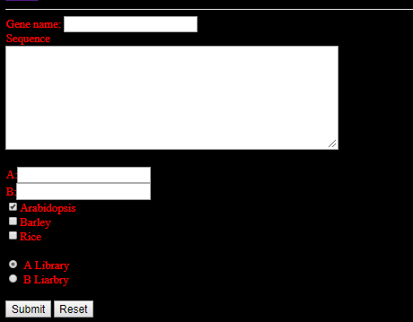
Example: http://140.113.118.199/~NYCU-BiOmicsLab/test.html
<form id="form" method="get" action="result.php">
Gene name: <input name="seq_name" type="text" ><br>
Sequence <br>
<textarea name="sequence" cols="50" rows="8"> </textarea> <br><br>
A:<input name="a_value" type="text"><br>
B:<input name="b_value" type="text"><br>
<input name="arab" type="checkbox" value="ON" checked="checked">Arabidopsis <br>
<input name="barley" type="checkbox" value="ON">Barley<br>
<input name="rice" type="checkbox" value="ON">Rice<br><br>
<input name="library" type="radio" value="A" checked="checked"> A Library<br>
<input name="library" type="radio" value="B"> B Liarbry
<br><br>
<INPUT TYPE="SUBMIT" VALUE="Submit" NAME="submit">
<INPUT TYPE="RESET" VALUE="Reset" NAME="reset">
</form>

Slide 6
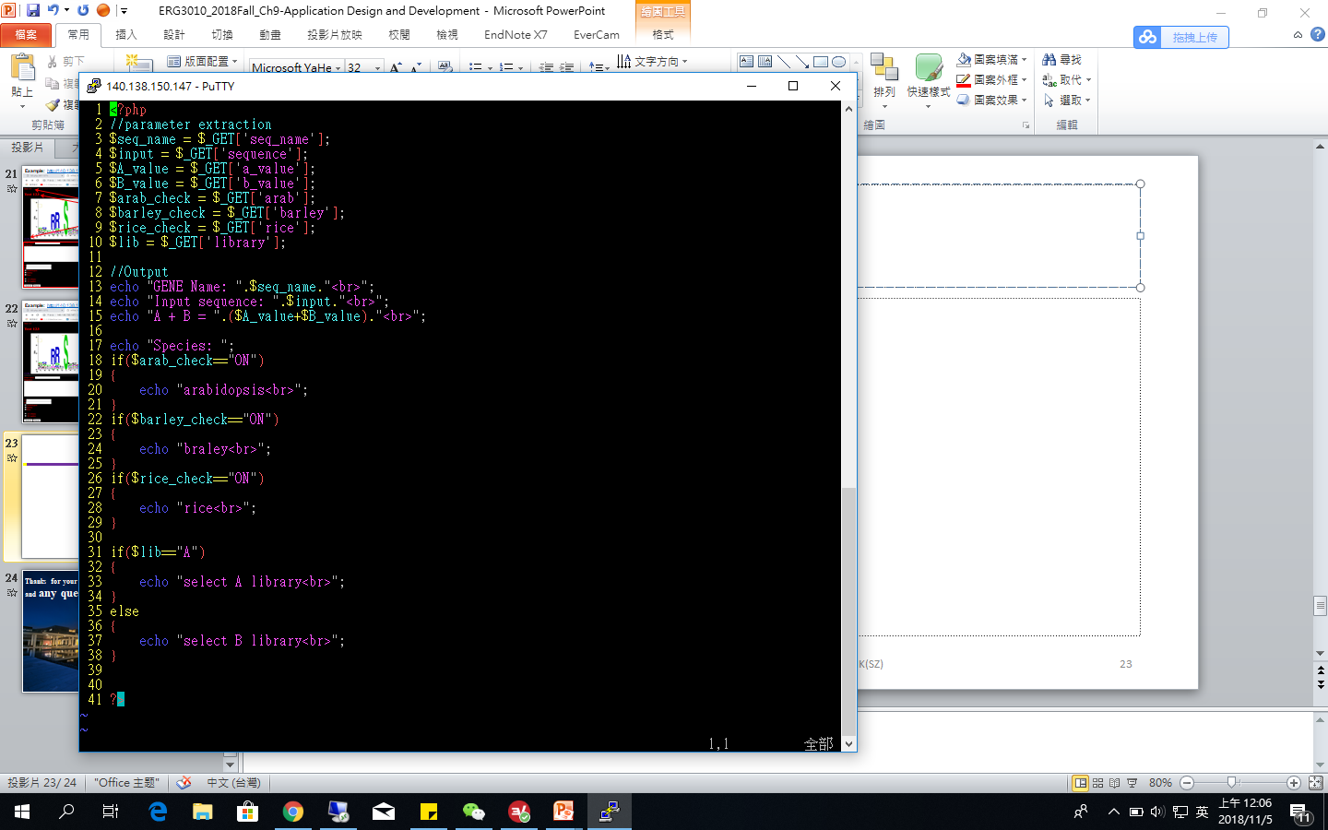
result.php

Slide 7
http://140.113.118.199/~NYCU-BiOmicsLab/A00123/result.php?seq_name=aaa&sequence=dfdsfsdfdsfdsf&a_value=12&b_value=5&arab=ON&barley=ON&library=A&submit=Submit
result.php
1. Specifying a value of GET means the browser will add the form contents to the end of the URL.
2. GET results in the entire contents of the submission being visible in the URL.
GENE Name: aaa Input sequence: dfdsfsdfdsfdsf A + B = 17 Species: arabidopsis braley select A library

Slide 8
<form method=”POST”>
<form id="form" method=“post“ action="result_post.php">
Gene name: <input name="seq_name" type="text" ><br>
Sequence <br>
<textarea name="sequence" cols="50" rows="8"> </textarea> <br><br>
A:<input name="a_value" type="text"><br>
B:<input name="b_value" type="text"><br>
<input name="arab" type="checkbox" value="ON" checked="checked">Arabidopsis <br>
<input name="barley" type="checkbox" value="ON">Barley<br>
<input name="rice" type="checkbox" value="ON">Rice<br><br>
<input name="library" type="radio" value="A" checked="checked"> A Library<br>
<input name="library" type="radio" value="B"> B Liarbry
<br><br>
<INPUT TYPE="SUBMIT" VALUE="Submit" NAME="submit">
<INPUT TYPE="RESET" VALUE="Reset" NAME="reset">
</form>

Slide 9
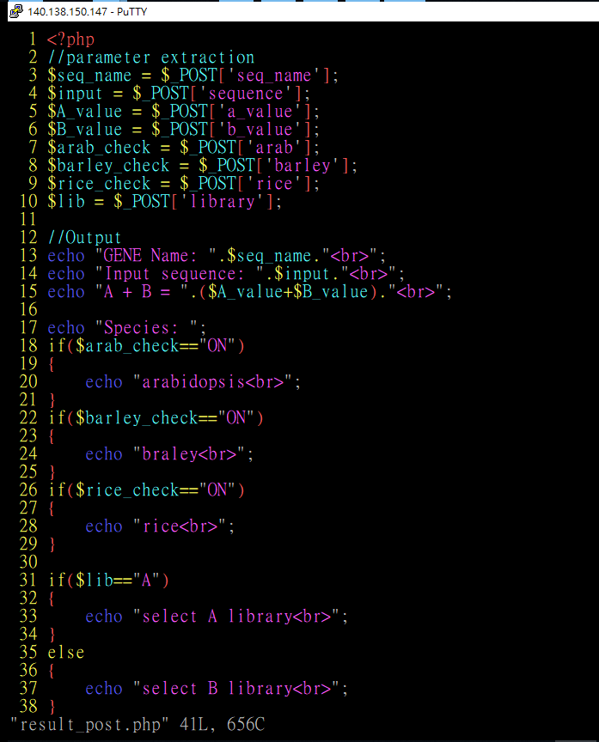
http://140.113.118.199/~NYCU-BiOmicsLab/A00123/result_post.php
<?php
//parameter extraction
$seq_name = $_POST['seq_name'];
$input = $_POST['sequence'];
$A_value = $_POST['a_value'];
$B_value = $_POST['b_value'];
$arab_check = $_POST['arab'];
$barley_check = $_POST['barley'];
$rice_check = $_POST['rice'];
$lib = $_POST['library'];
//Output
echo "GENE Name: ".$seq_name."<br>";
echo "Input sequence: ".$input."<br>";
echo "A + B = ".($A_value+$B_value)."<br>";
……

Slide 10
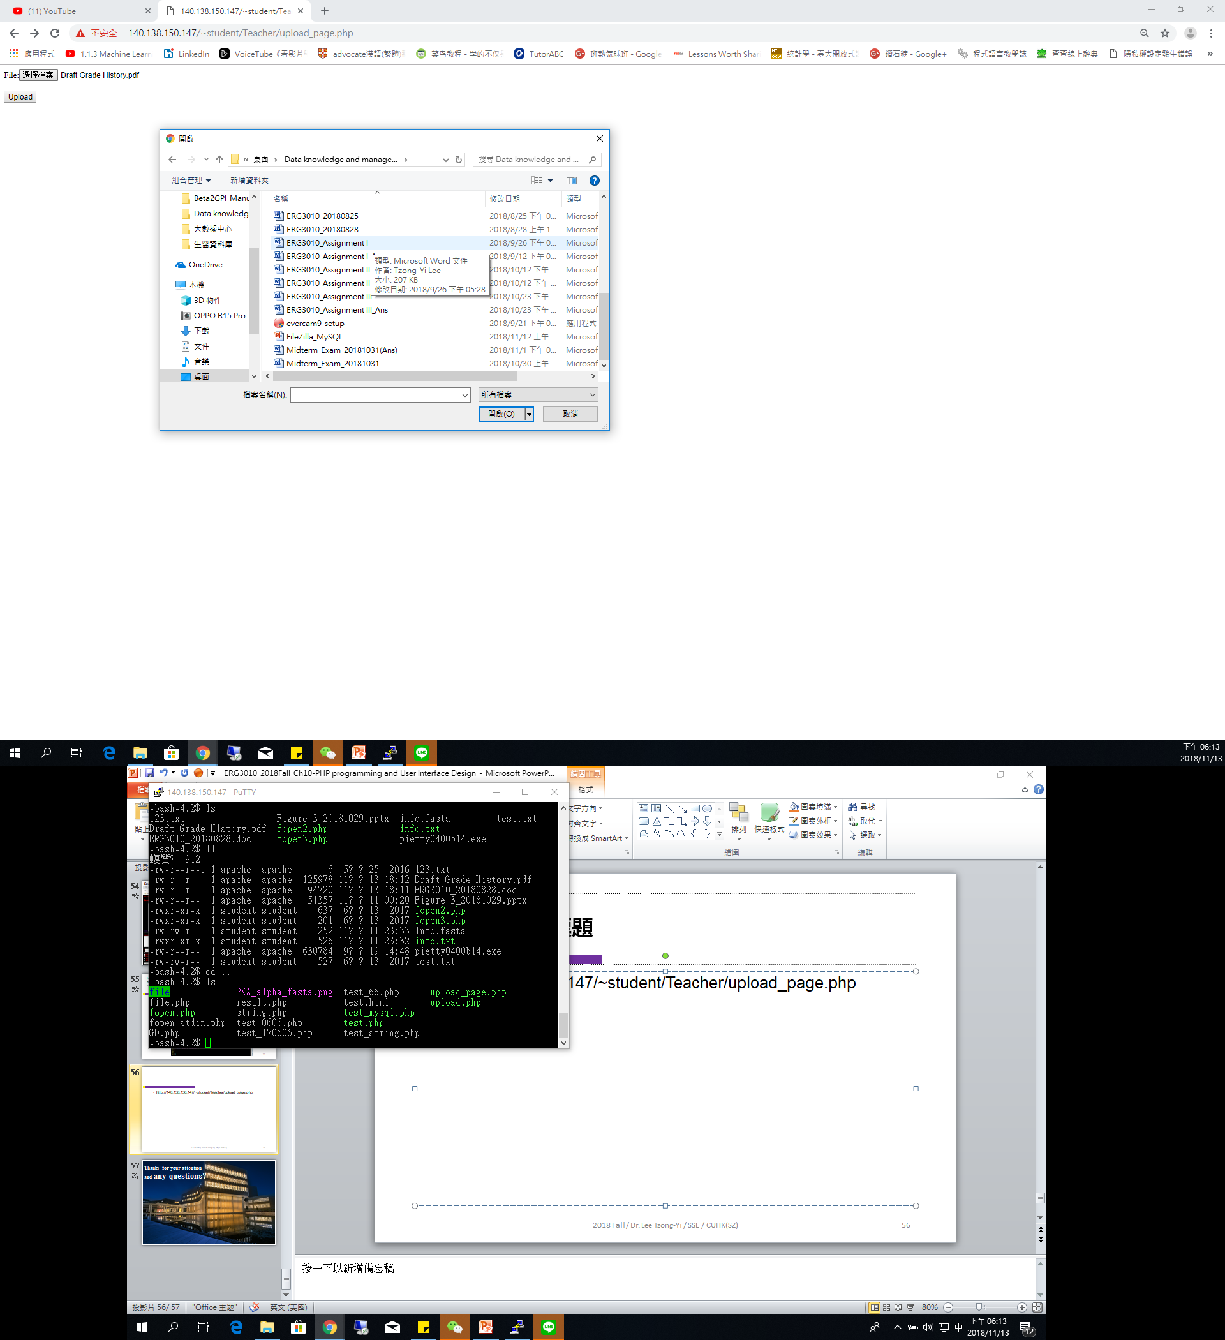
File upload through Web page
http://140.113.118.199/~NYCU-BiOmicsLab/A00123/upload_page.php
<form action="upload.php" method="post" enctype="multipart/form-data">
File:<input type="file" name="file" id="file" /><br /><br/>
<input type="submit" name="submit" value="Upload" />
</form>
Name:ERG3010_Assignment I.docx Type:application/vnd.openxmlformats-officedocument.wordprocessingml.document Size:207.9248046875 Kb Address:/tmp/phpYBksU1

Slide 11
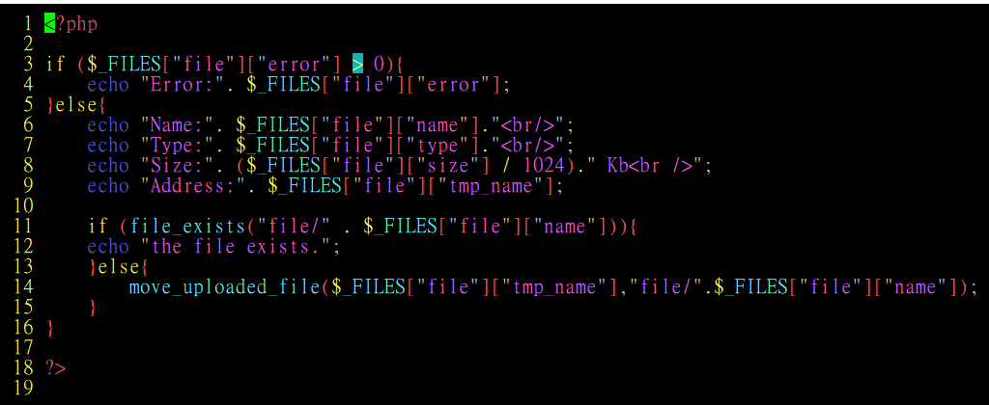
File upload through Web page
http://140.113.118.199/~NYCU-BiOmicsLab/A00123/upload.php

Slide 12
Imaging function - GD library
http://php.net/manual/en/ref.image.php

Slide 13
Introduction of GD
PHP is not limited to creating just HTML output. It can also be used to create and manipulate image files in a variety of different image formats, including GIF, PNG, JPEG, WBMP, and XPM.
Even more conveniently, PHP can output image streams directly to a browser. You will need to compile PHP with the GD library of image functions for this to work.
GD and PHP may also require other libraries, depending on which image formats you want to work with.

Slide 14
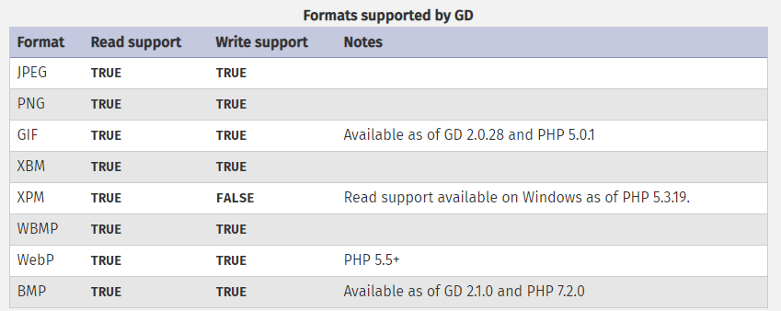
Formats supported by GD
GD supports a variety of formats, below is a list of formats supported by GD and notes to their availability including read/write support.

Slide 15
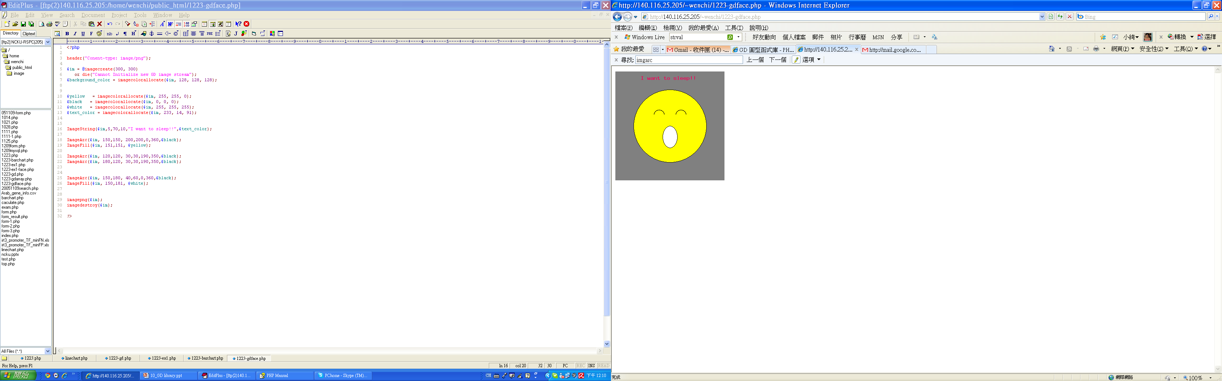

Slide 16
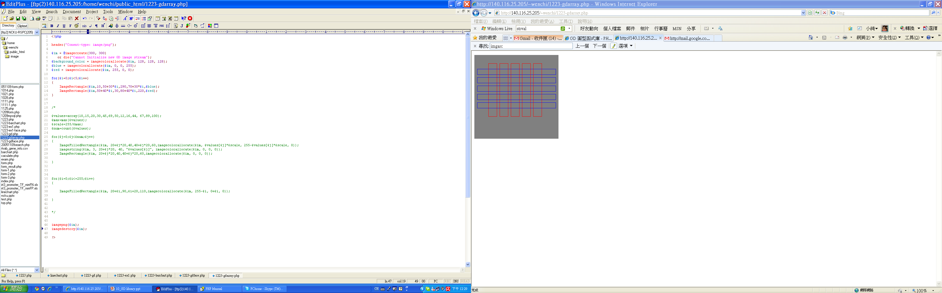
Example

Slide 17
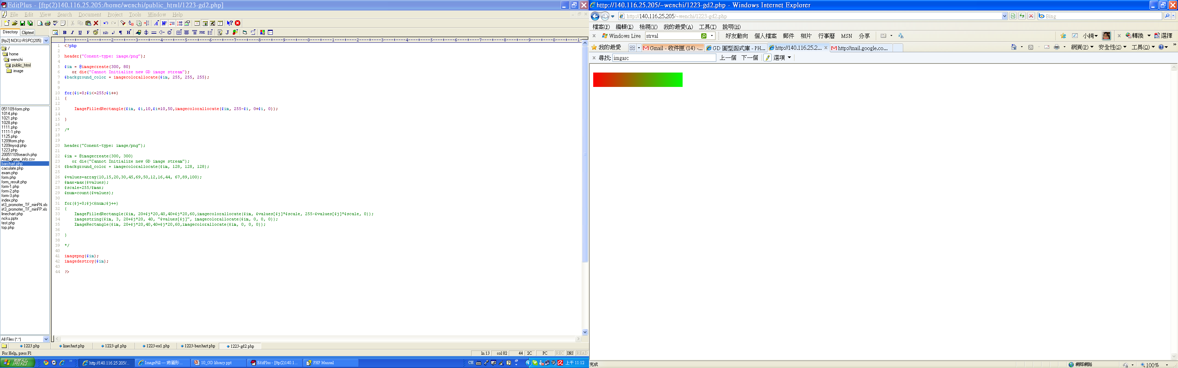

Slide 18
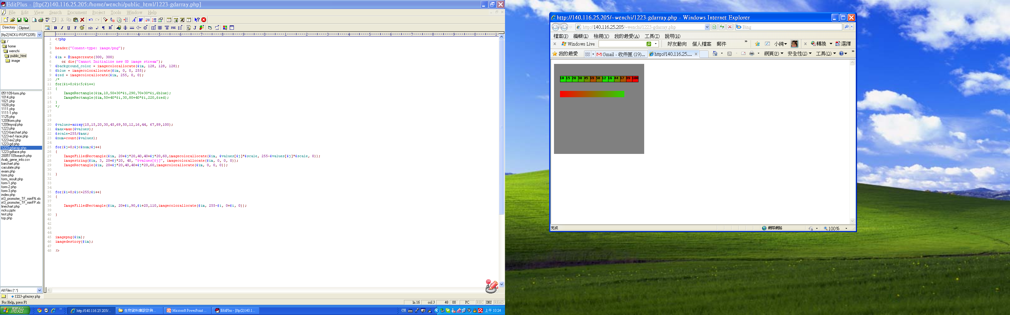

Slide 19
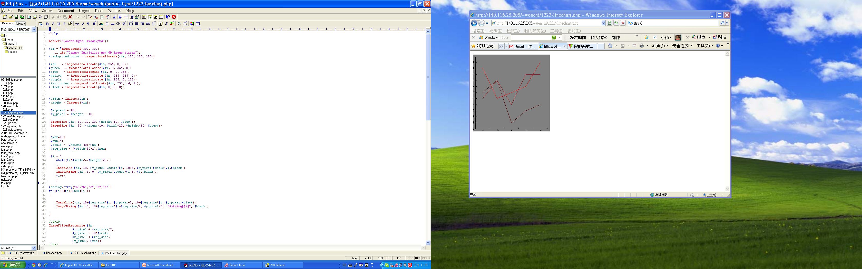
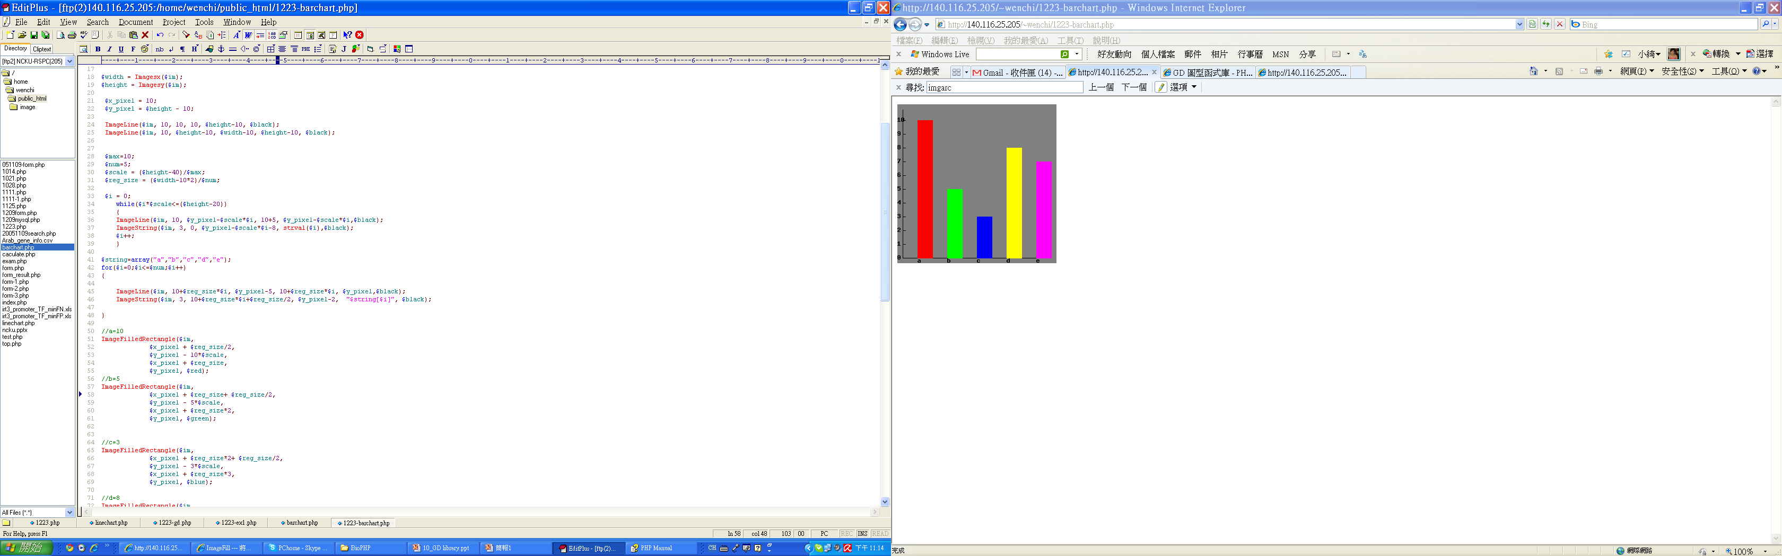

Slide 20


Slide 21
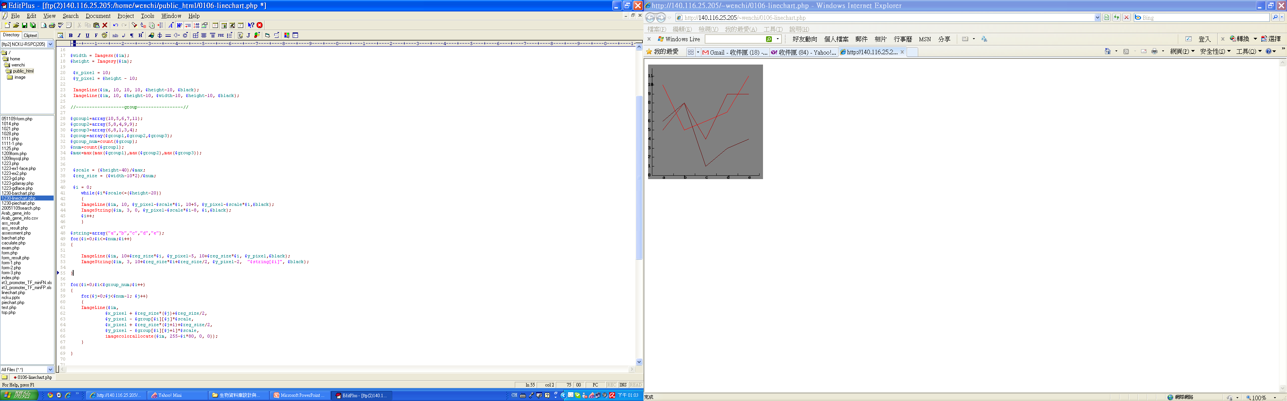

Two-dimensional array

Slide 22
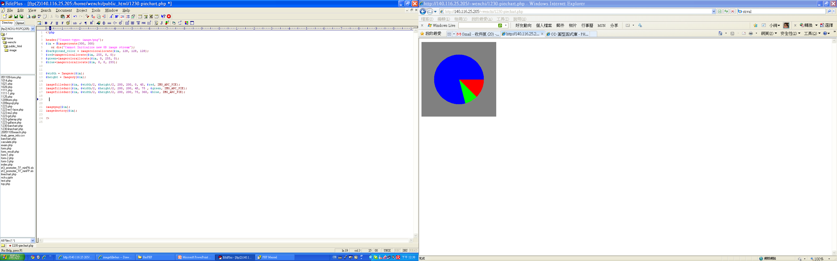

Slide 23
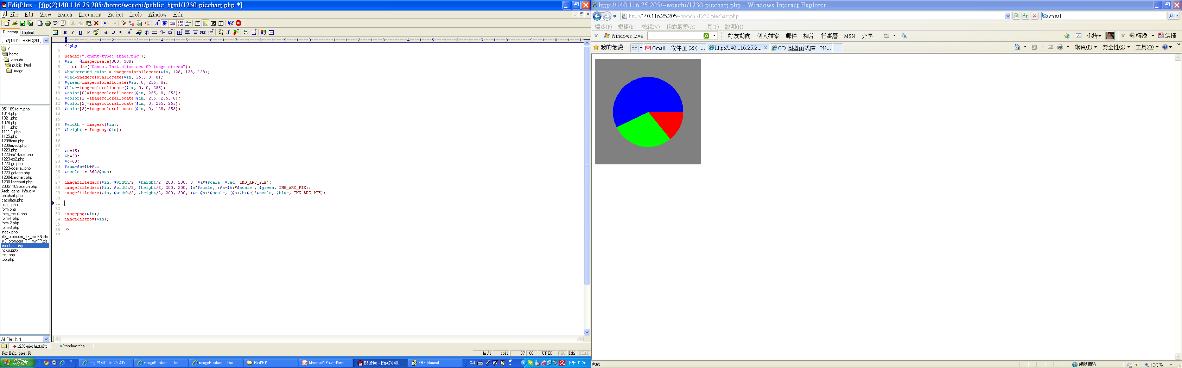
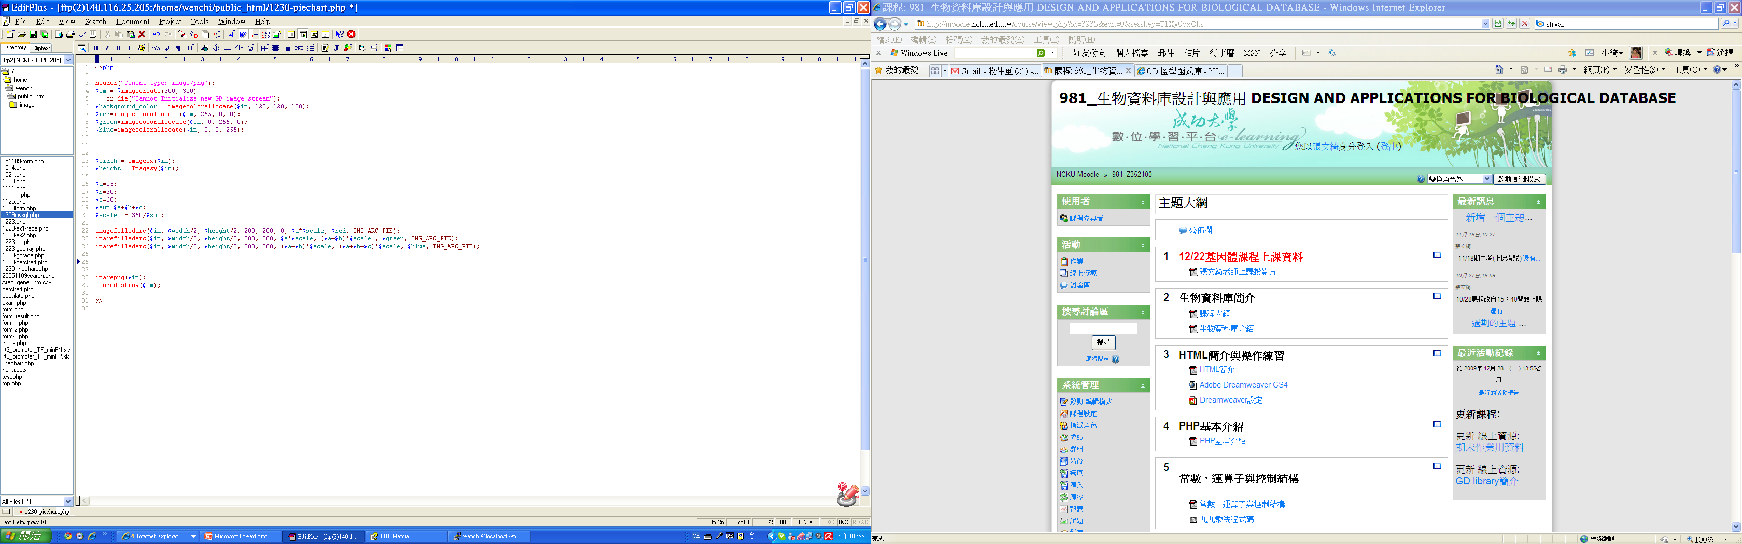

Slide 24
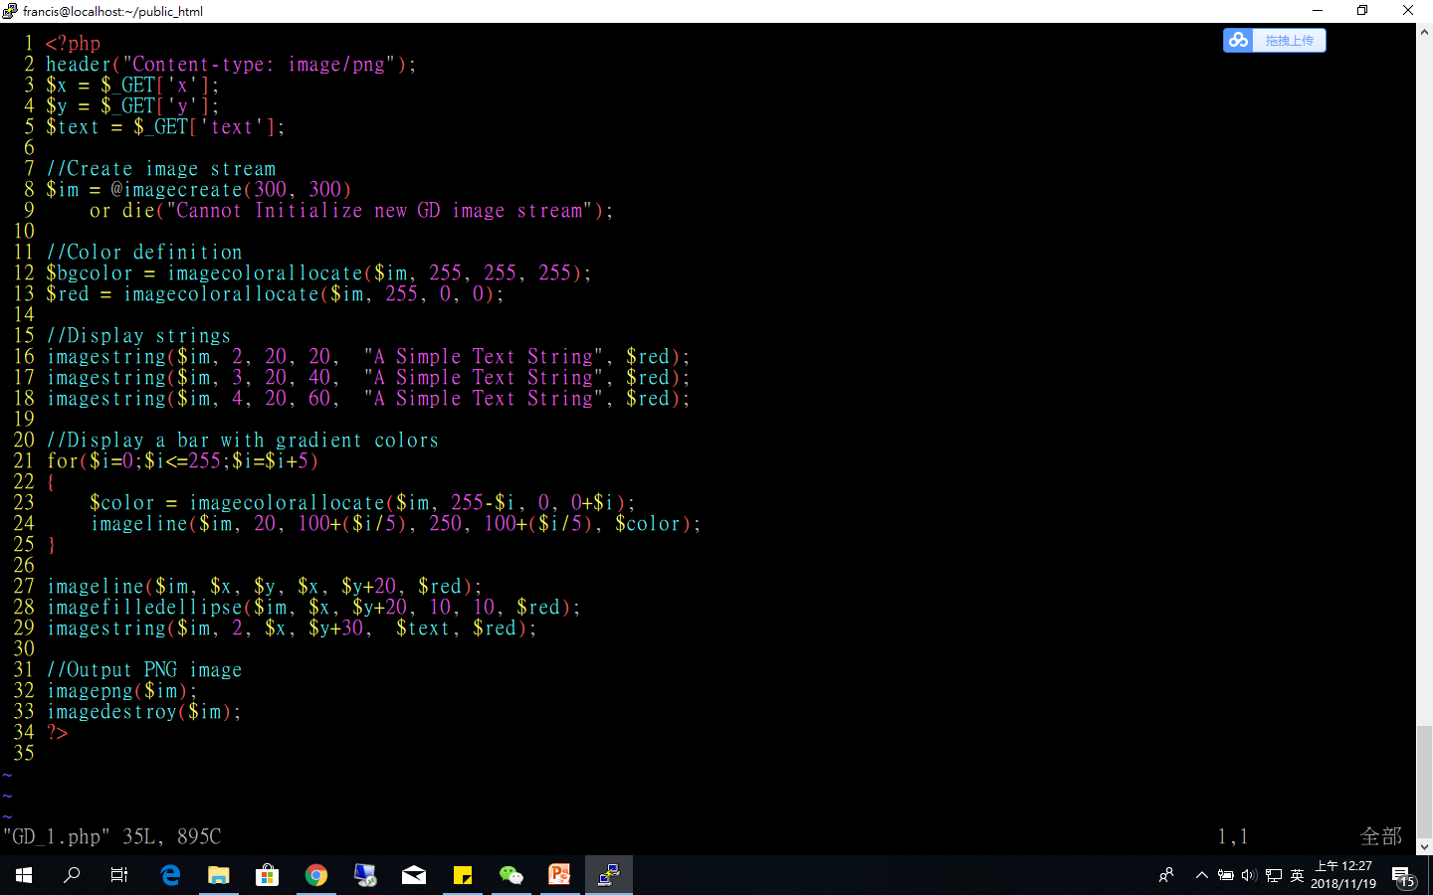
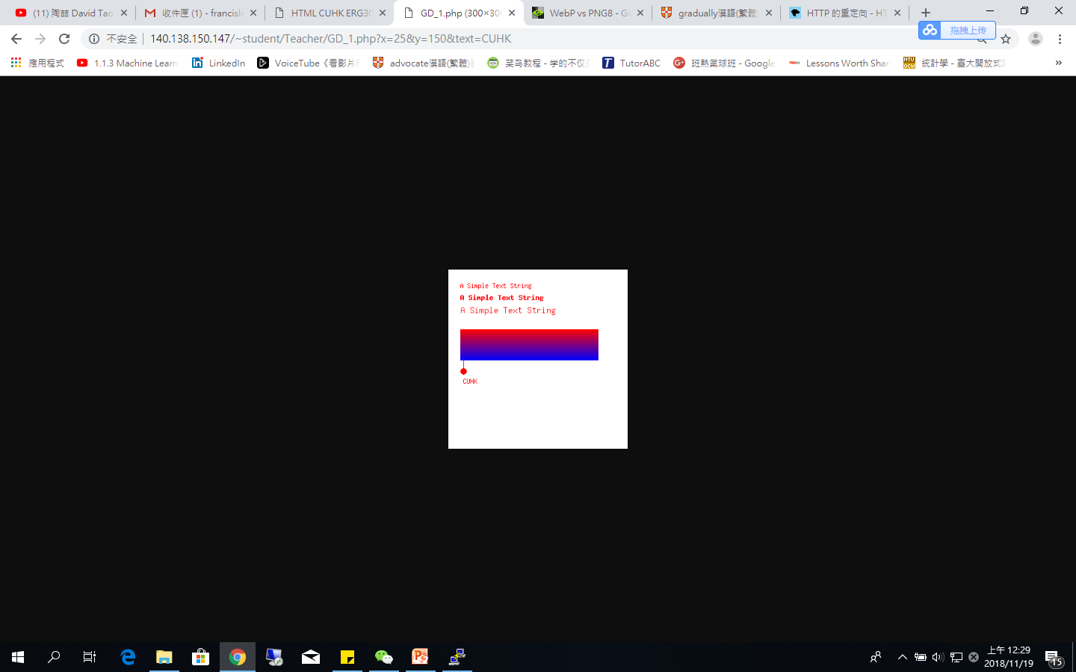
Image creation by using GD functions
http://140.113.118.199/~NYCU-BiOmicsLab/A00123/GD_1.php?x=25&y=150&text=CUHK
//header definition
//Get value from URL
//create image from png file
//Define color
//Define color
//Draw a line
//Draw a circle
//Output a PNG image to either the browser or a file
//Destroy an image

Slide 25
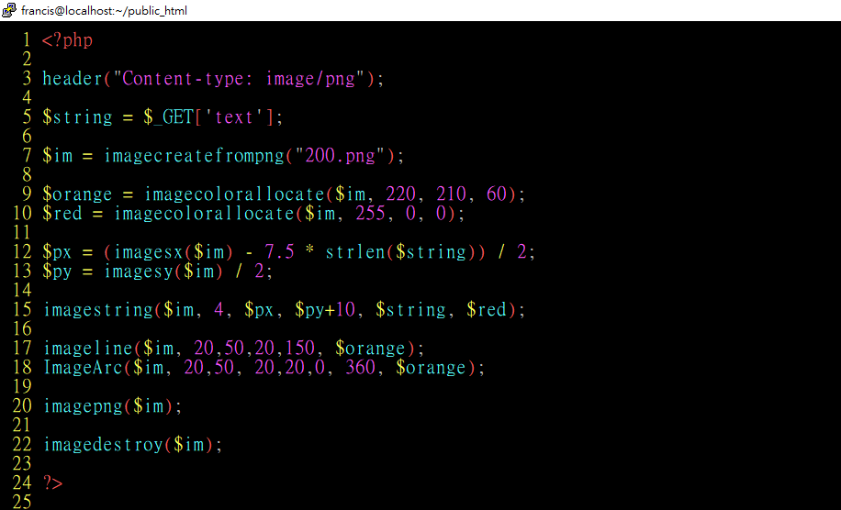
Image creation by using an existing picture
http://140.113.118.199/~NYCU-BiOmicsLab/A00123/GD.php?text=NYCU
//header definition
//Get value from URL
//create image from png file
//Define color
//Define color
//imagesx(): get image width
//imagesy(): get image height
//Draw a string horizontally
//Draw a line
//Draw a circle
//Output a PNG image to either the browser or a file
//Destroy an image

Slide 26
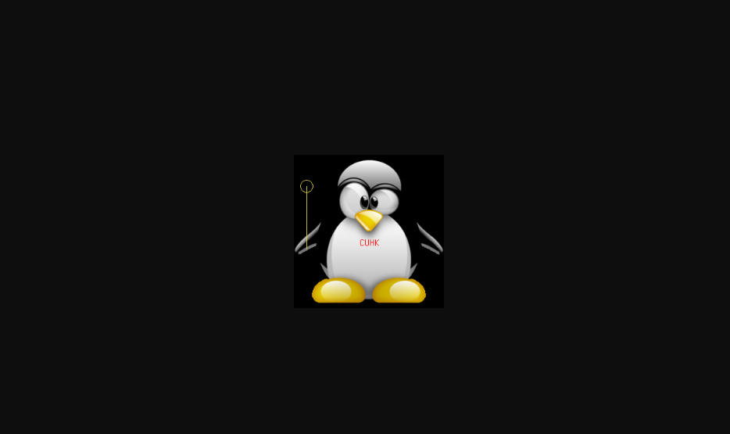
Image creation by using an existing picture
http://140.113.118.199/~NYCU-BiOmicsLab/A00123/GD.php?text=NYCU

Slide 27

Thank you and
any questions?

